Slide 1

Sentry6
16 Measured Pitching Stats
May 2026

Slide 2
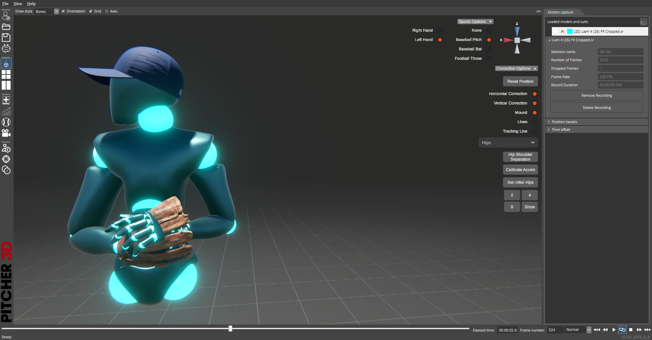
Pitch Start
The digital standard to start of the pitch is when the pitcher is finished visualizing the pitch and starts the motions to deliver a pitch

Slide 3
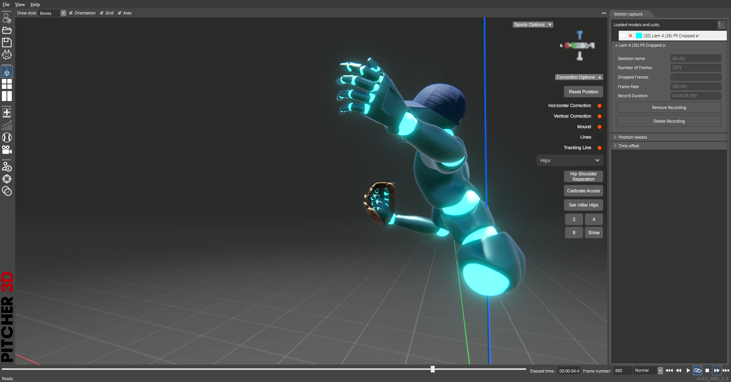
Pitch End
The ball release point is digitally considered the end of the pitch: fastest speed of the knuckles during the pitch

Slide 4
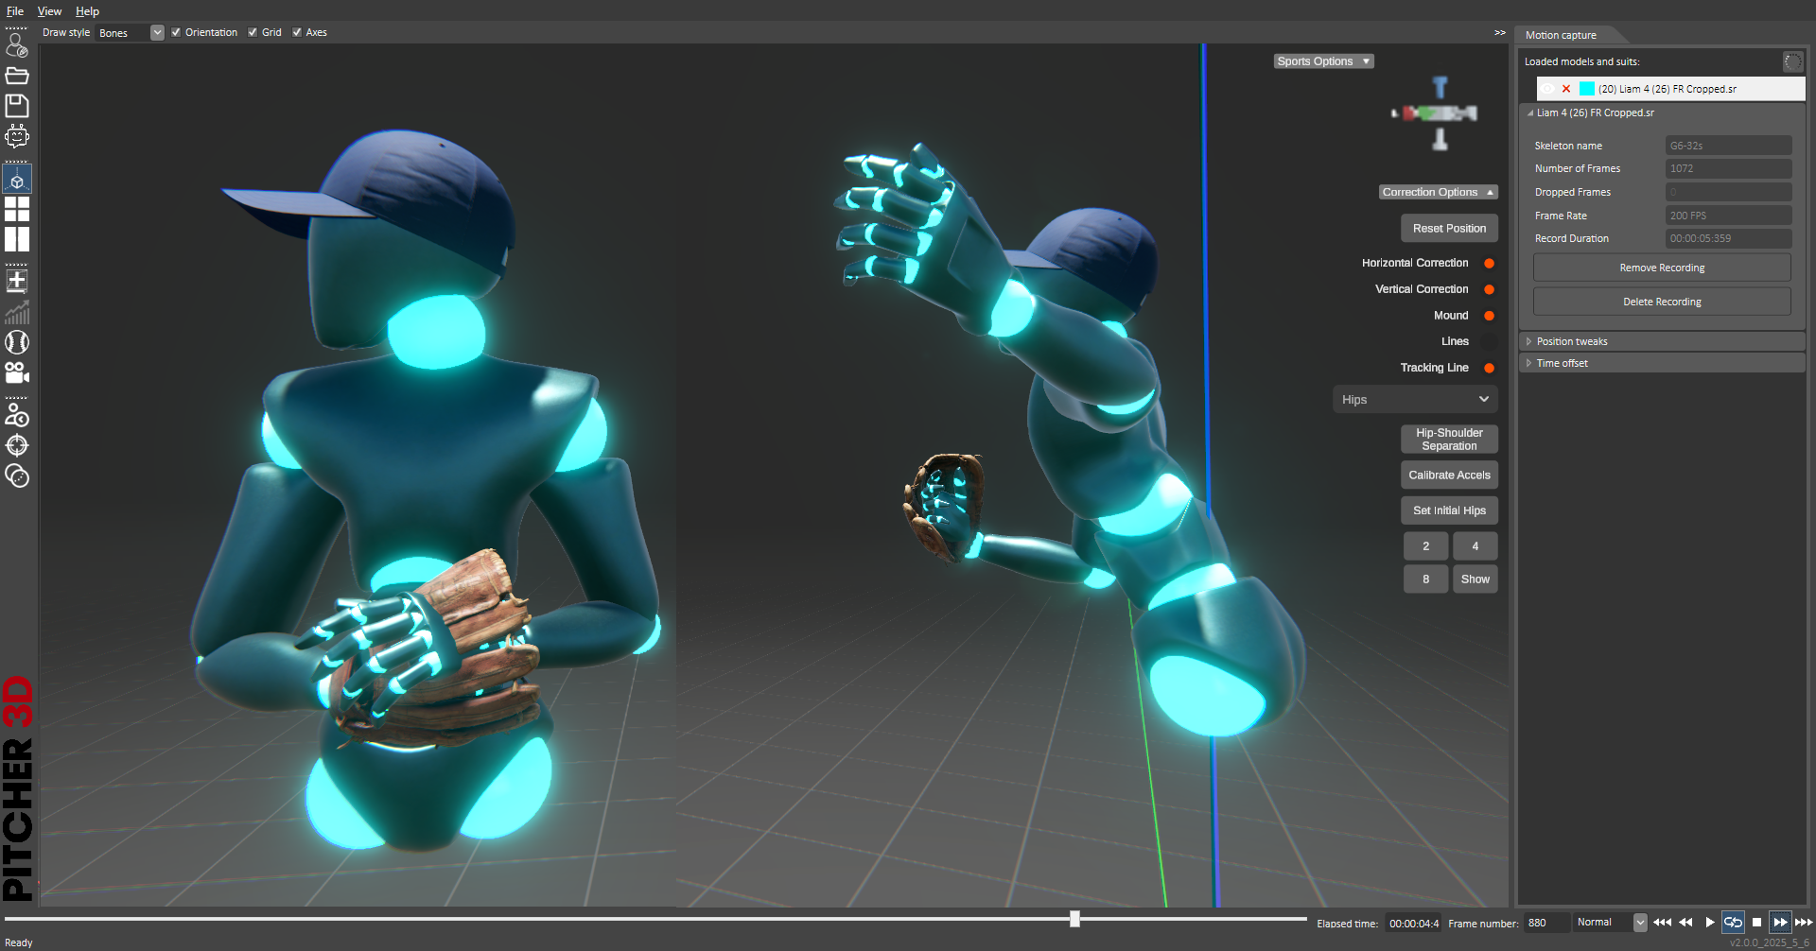
Pitch Duration
Pitch Duration calculation starts when the pitcher starts moving after setting up the pitch and ends when the pitching knuckles are at their fastest speed during the pitch

Slide 5
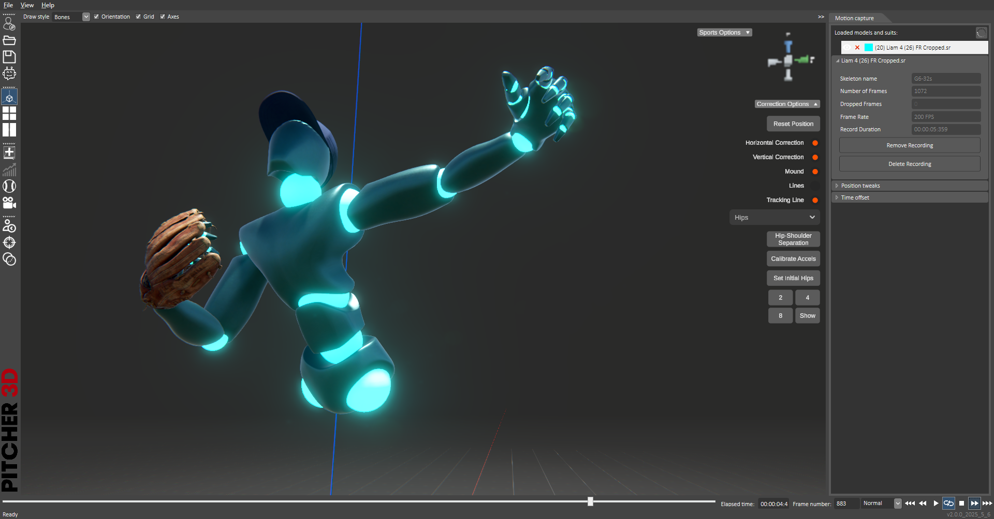
Max Palm Speed
= Fastest knuckle joint speed
Palm speed value indicates the highest speed achieved at the middle finger knuckle (the fastest moving point on the body during a pitch, ignoring the finger speeds). The palm speed at the release point is the closest speed to the ball speed at release point.

Slide 6
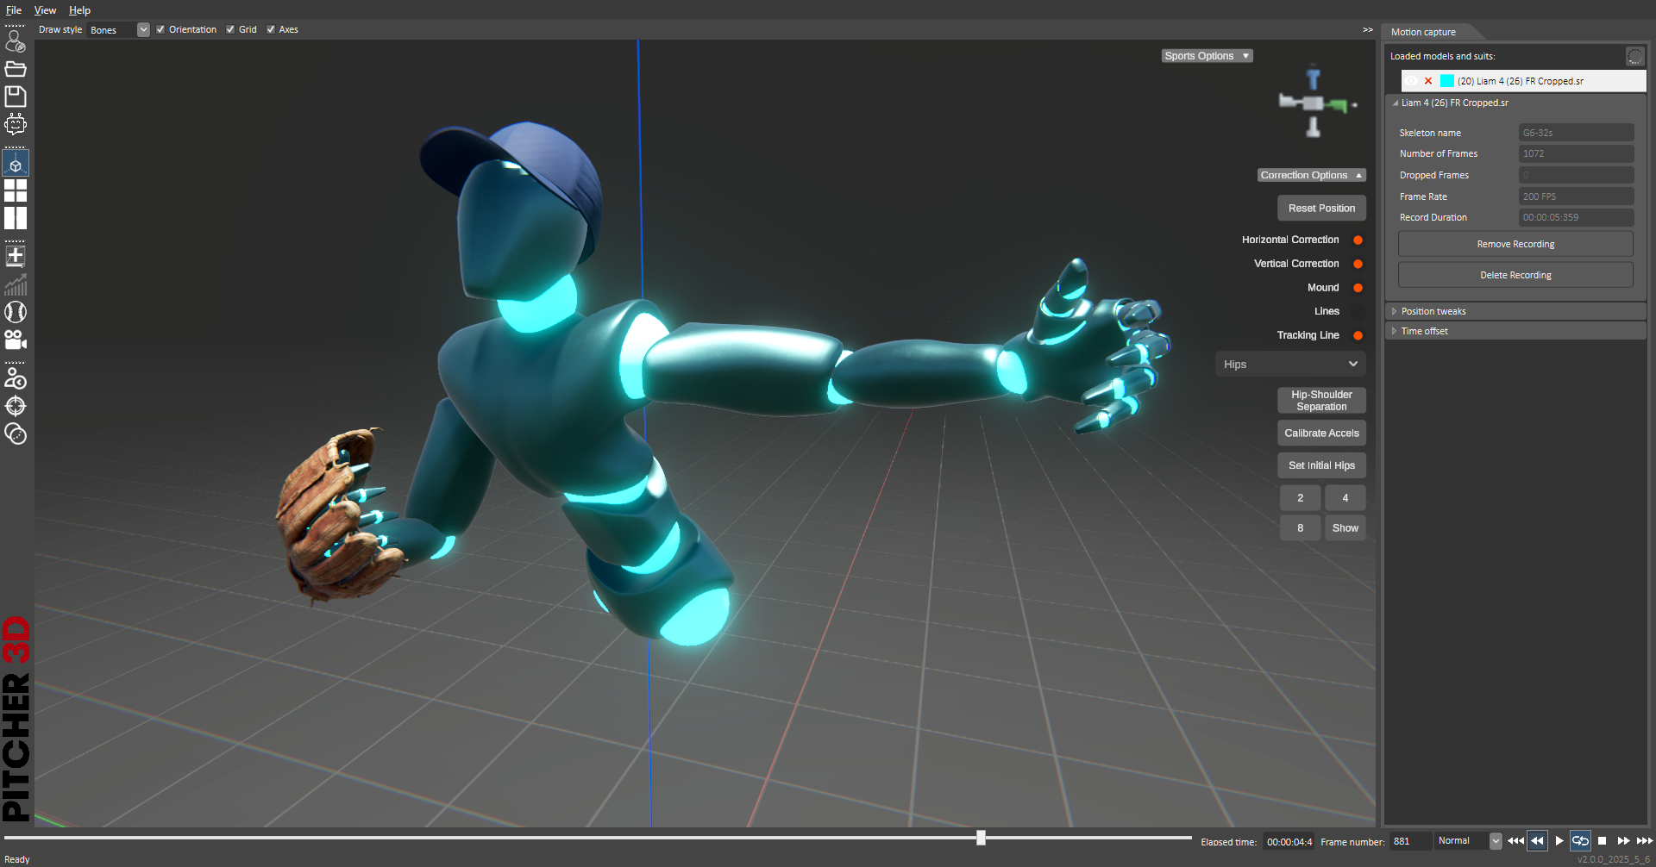
= Fastest wrist joint speed
Max Forearm Speed
Forearm speed value indicates the highest speed achieved at the center of the wrist joint during the pitch

Slide 7
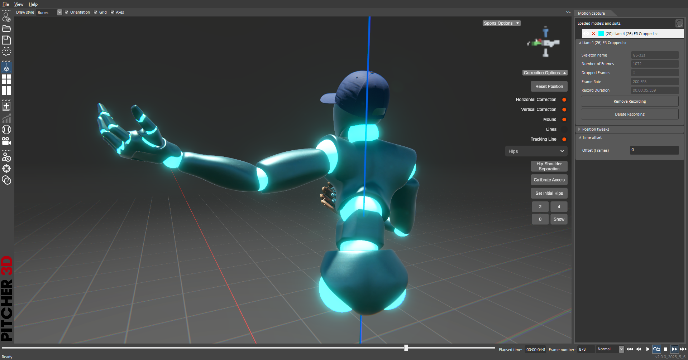
= Fastest elbow joint speed
Max Arm Speed
Arm speed value indicates the highest speed achieved at the center of the Elbow joint during the pitch

Slide 8
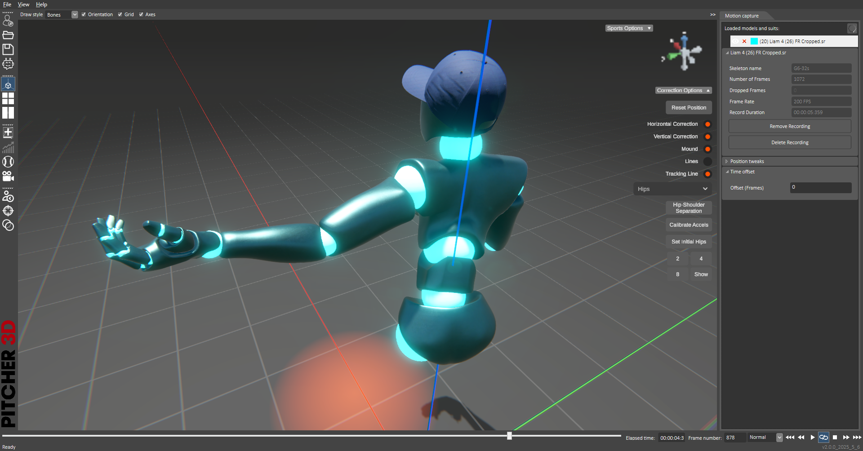
Max Shoulder Speed
= Fastest shoulder joint speed
Indicates the highest speed achieved at the center of the shoulder joint during the pitch

Slide 9
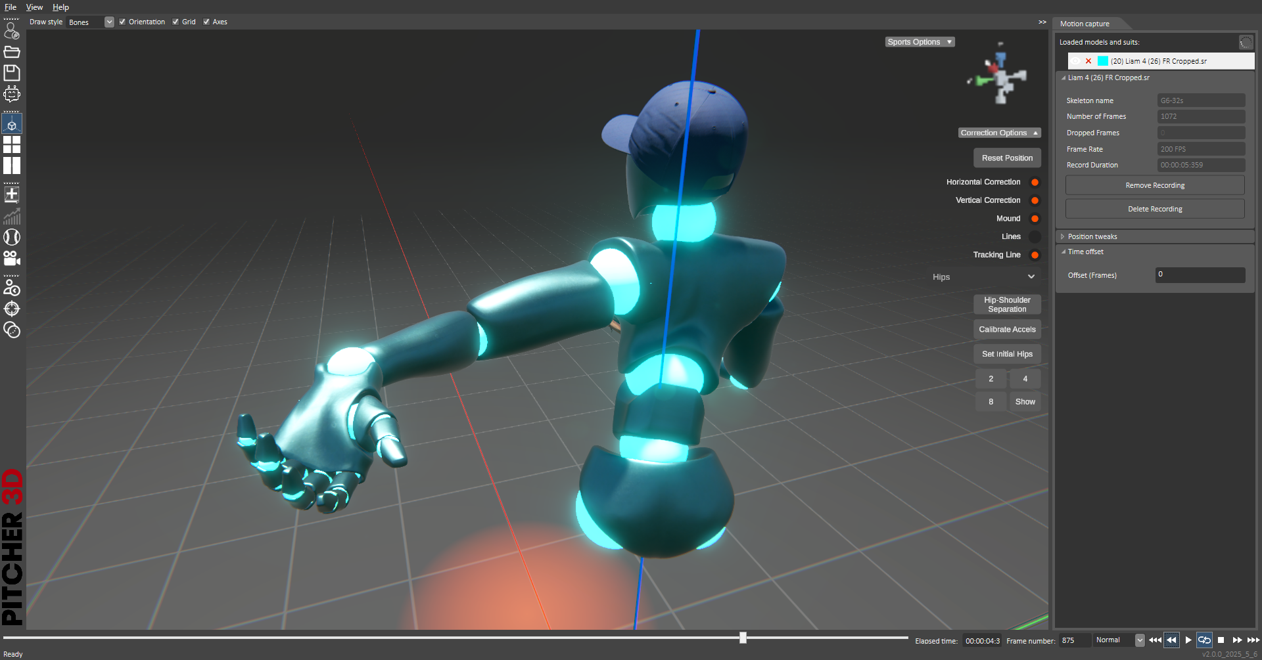
Max Wrist Angular Velocity
= Maximum wrist joint angular velocity
Wrist angular velocity is derived from the angular measurement between the palm and the forearm. The knuckles speed at the release point is the closest speed to the ball speed at release point.

Slide 10
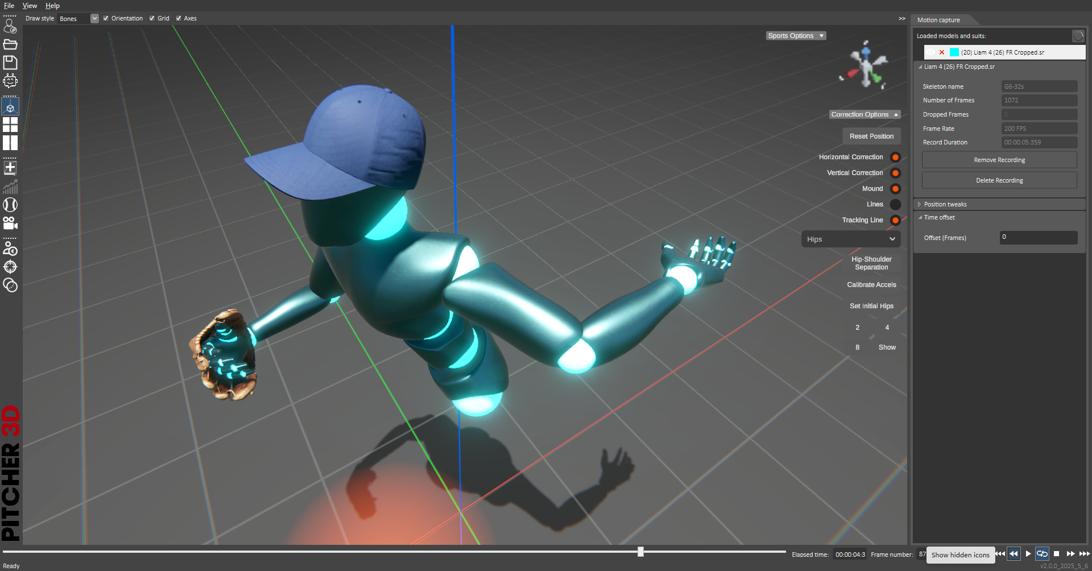
= Maximum elbow joint angular velocity
Max Elbow Angular Velocity
Elbow angular velocity is derived from the angular measurement between the forearm and the upper arm.

Slide 11
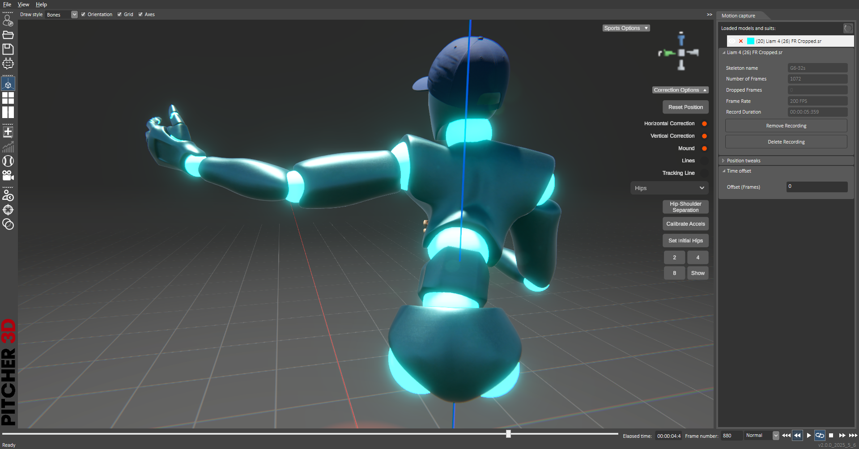
= Fastest shoulder joint angular velocity
Max Shoulder Angular Velocity
Shoulder joint angular velocity here is derived from the angular measurement between the upper arm and the pitcher’s ribcage

Slide 12
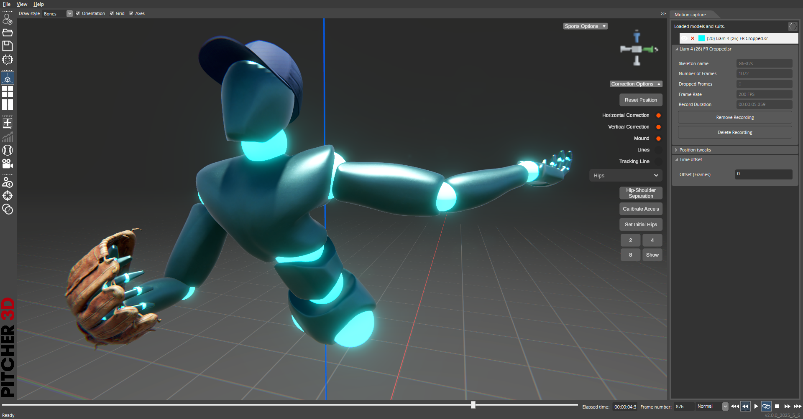
Max Chest Angular Velocity
= Fastest angular velocity
of the Ribcage pivot
The maximum velocity the ribcage pivot achieves around its center during the pitch

Slide 13
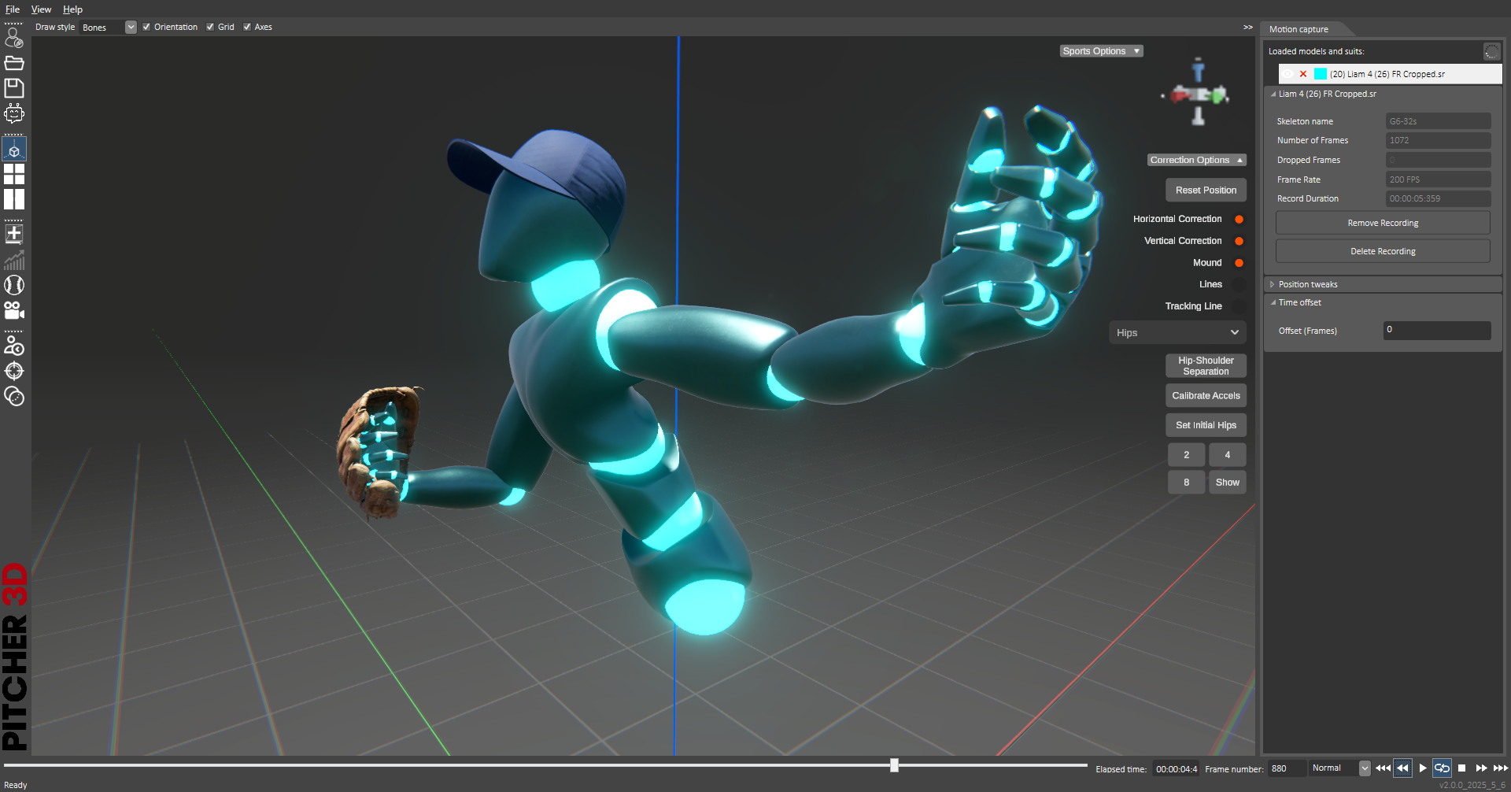
Max Hips Angular Velocity
= Fastest angular velocity in the
hip pivot
The maximum velocity of the Hips in its pivot around its center

Slide 14
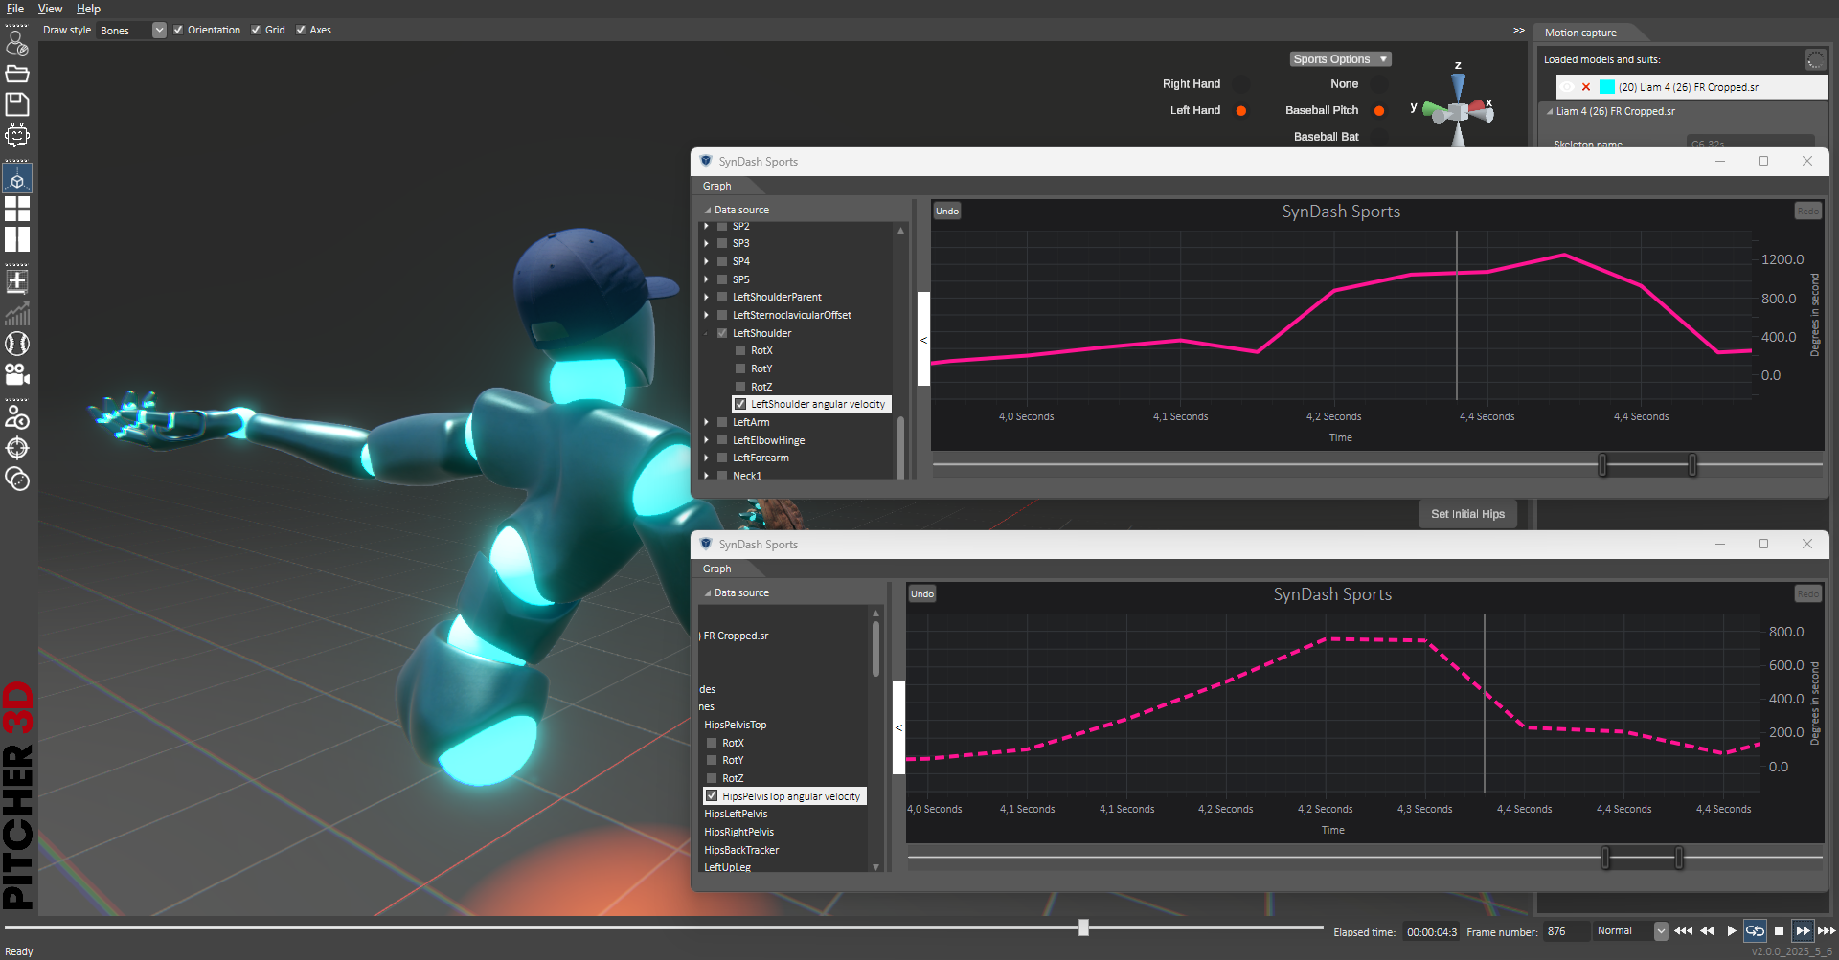
Hips to Shoulder Peaks
B
B
A
A
Length of time between the peak angular velocity of the Hips (A) and the peak angular velocity of the shoulder (B, includes Chest AV)

Slide 15
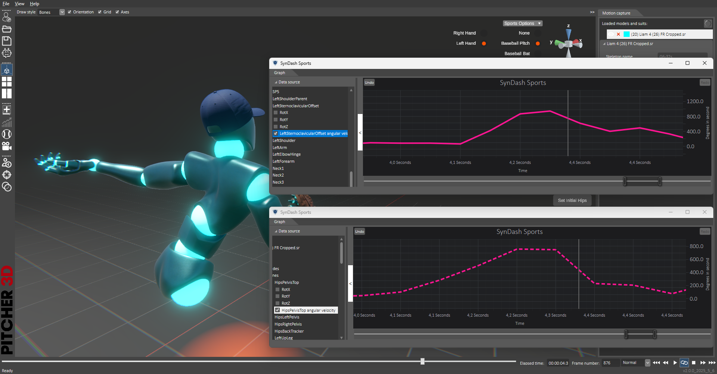
Shoulder Separation
B
B
A
A
Length of time between the peak angular velocity of the Hips (A) and the peak angular velocity of the Ribcage (B)

Slide 16
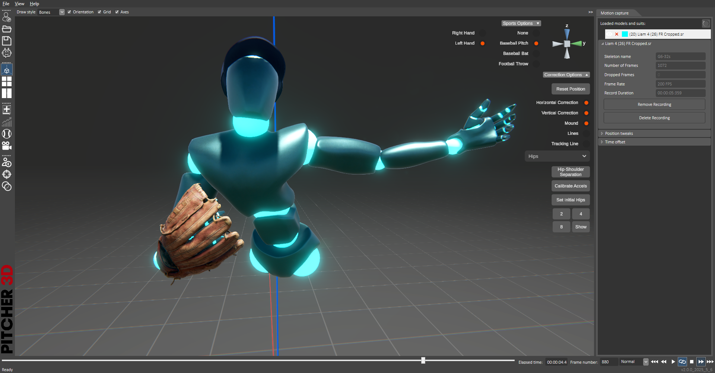
C
90
A
B
= Angle between Line B
and line C at release
Forearm Tilt
How open is the elbow angle at release, in reference to the elbow being at 90 degrees (line C)

Slide 17
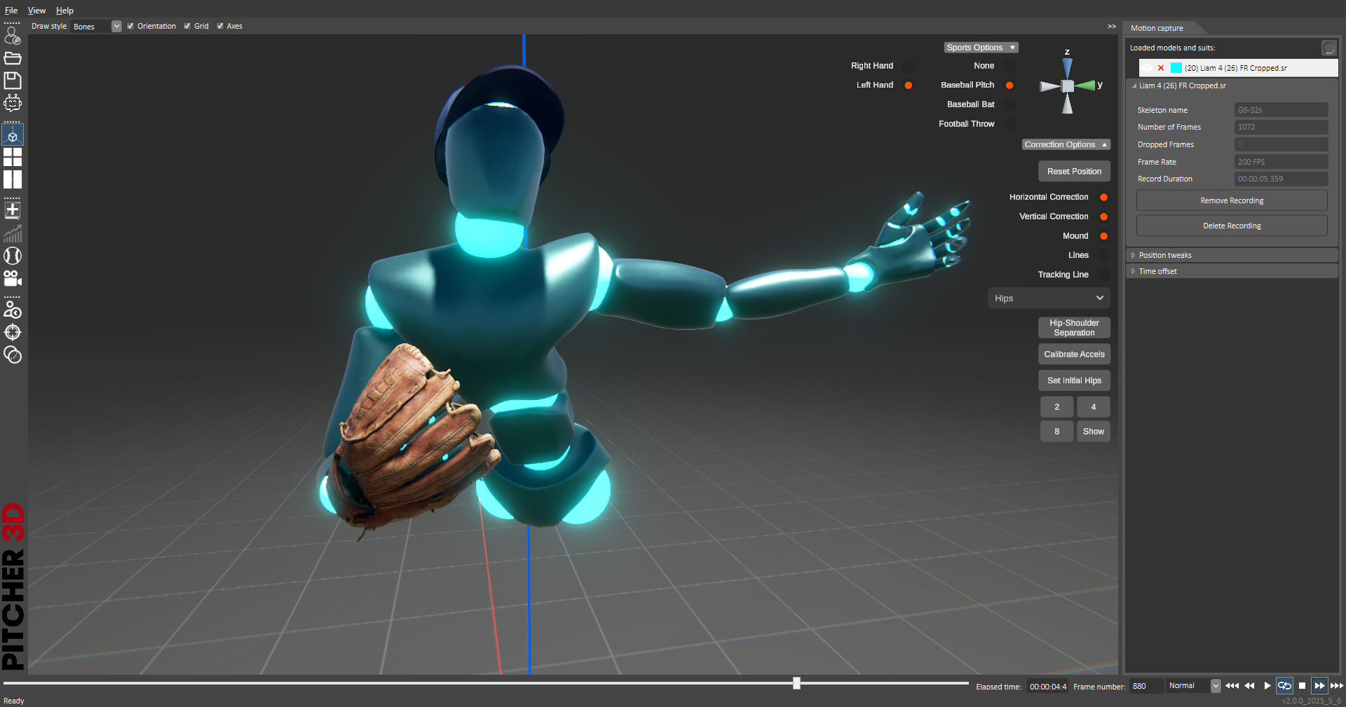
Elbow Height
B
A
Elbow joint height to shoulder joint at release, referenced to chest
How high did the center of the elbow joint raise in reference to the shoulder in the frontal plane at release point

Slide 18
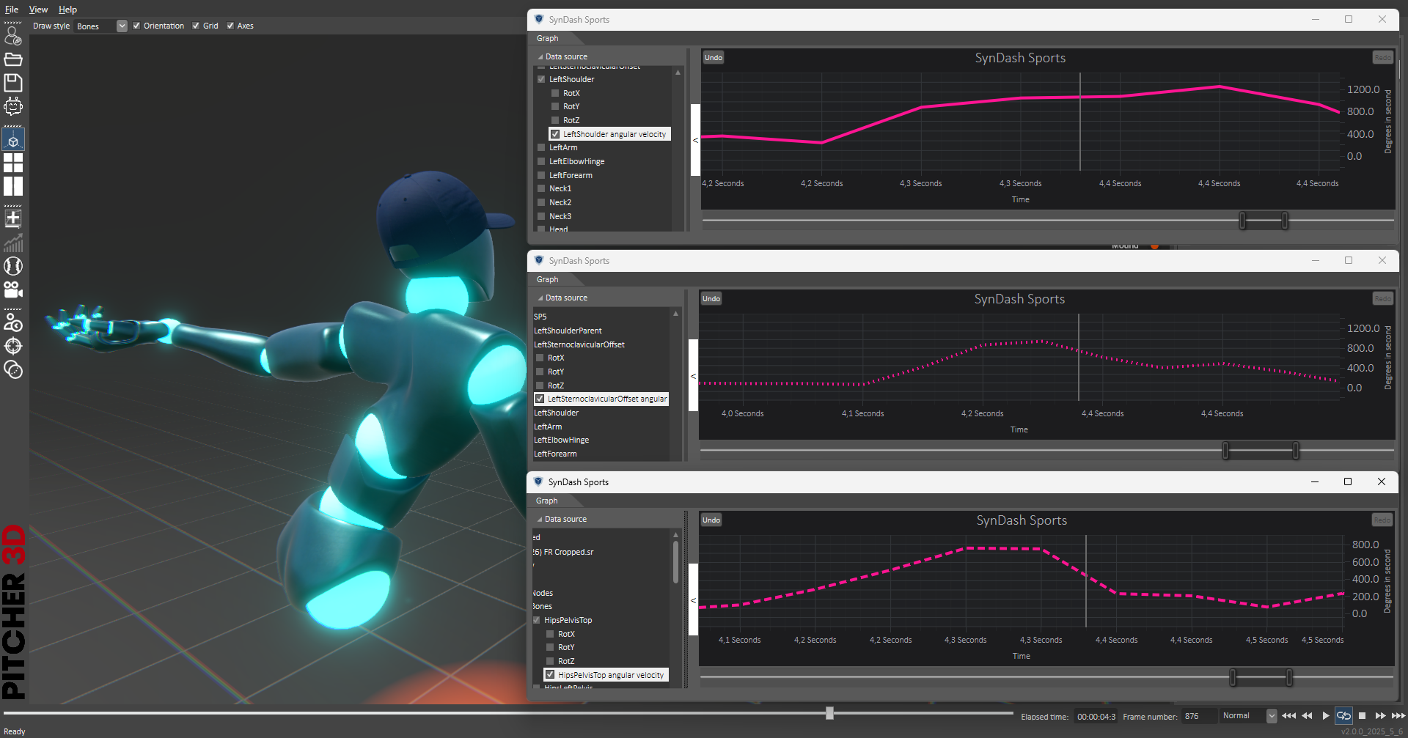
Add graphs to the stats like this

Slide 19
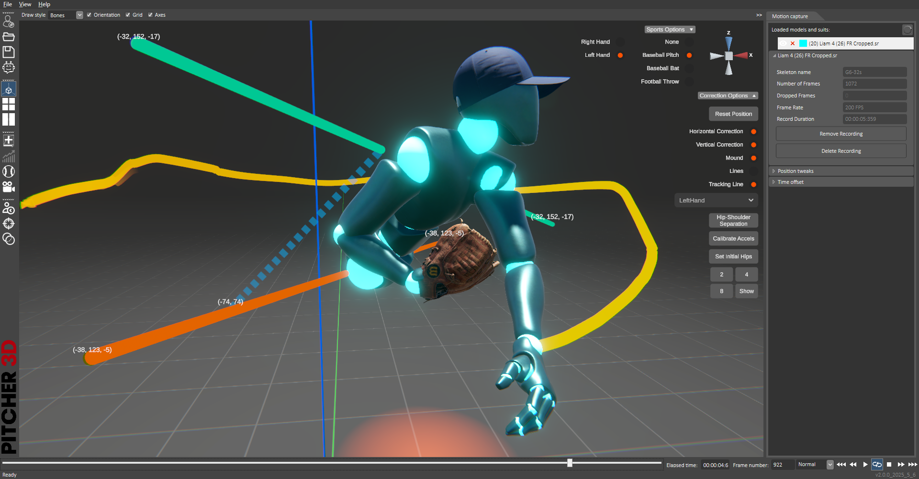
Or like this…

